Slide 1
Exercise-1
Construct an E-R diagram for a car insurance company whose customers own one or more cars each. Each car has associated with it zero to any number of recorded accidents. Each insurance policy covers one or more cars and has one or more premium payments associated with it. Each payment is for a particular period of time, and has an associated due date, and the date when the payment was received.

Slide 2
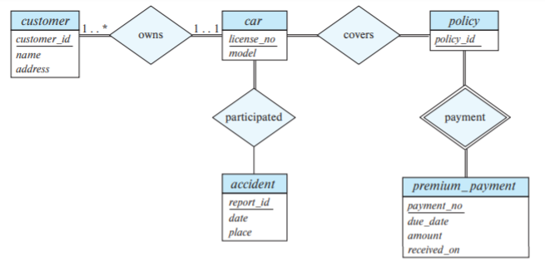
Solution

Slide 3
Exercise-2
Design an E-R diagram for keeping track of the exploits of your favorite sports team. You should store the matches played, the scores in each match, the players in each match and individual player statistics for each match. Summary statistics should be modeled as derived attributes.

Slide 4
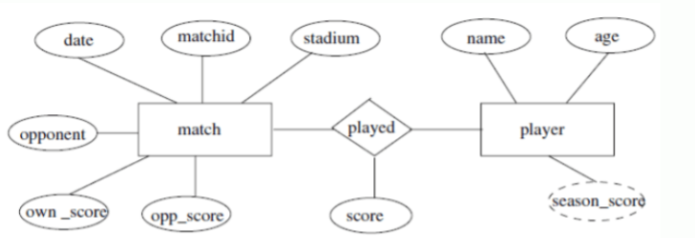
Solution

Slide 5
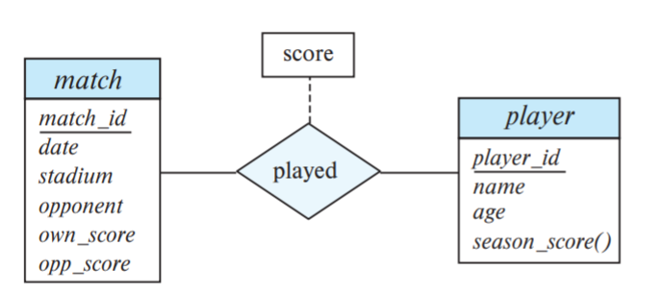
Alternative Solution

Slide 6
Exercise-3
Extend the E-R diagram of the previous question to track the same information for all teams in a league.

Slide 7
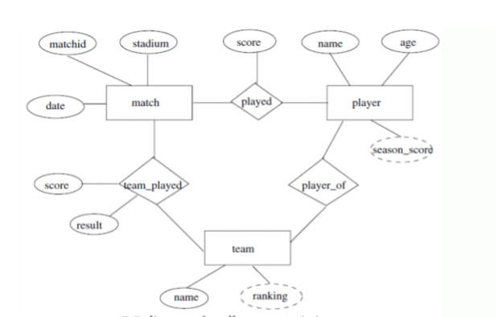
Solution

Slide 8
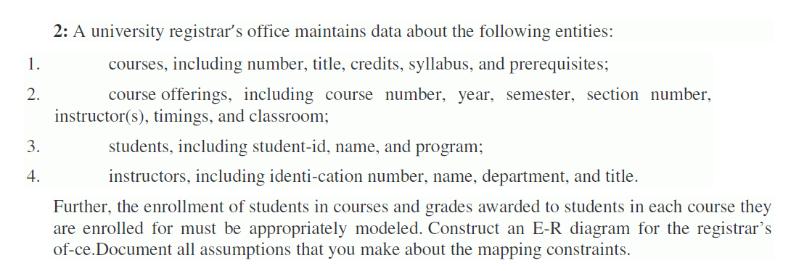
Exercie-4

Slide 9
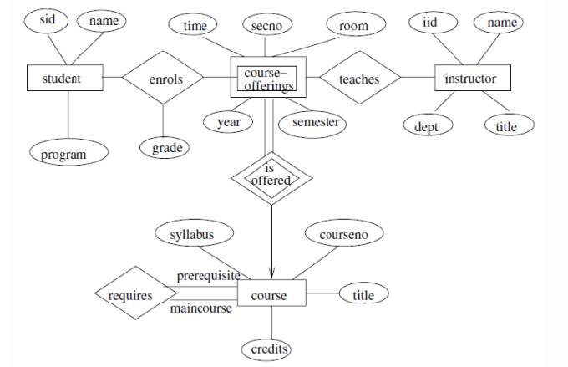
Solution

